Slide 1


Step 1: Ask
Walmart Sales Analysis Presentation
Identifying the patterns in our products, regions, categories and customer segments for efficiency and profit optimization with SQL
With technology evolving rapidly, establishing robust databases and dedicated departments for interpreting them is essential for staying ahead in efficiency. While execution is crucial, having high-quality inputs ensures even better outputs. As market demand and competition intensify, it's imperative to leverage insights to deliver enhanced value to customers, as value remains paramount.
Our analysis will utilize Excel, SQL, and Tableau. Excel will serve as the initial data repository, SQL will extract meaningful insights, and Tableau will visualize the data effectively. Following the six steps of Data Analysis - Ask, Prepare, Process, Analyze, Share, and Act.
pa
Step 1: Ask
In this stage, we will articulate the business challenge presented to us, which has been interpreted as "Identifying the optimal products, regions, categories, and customer segments for the Walmart to prioritize or steer clear of, aiming to amplify profitability."
Business objectives:
How can we optimize our profits?
What are the emerging trends that we can we identify?
How can we take these insights to build recommendations ?
Deliverables:
Concise overview of the business goals.
Comprehensive documentation detailing data cleansing, manipulation, and analysis.
Dashboard showcasing visualizations and key findings.
Recommendations derived from our insights and analysis.
In this phase, we will identify and assess the features of our Walmart Dataset:
It comes with 8400 rows with 8400 being pure data and the other one row being the column headers. It contains data recorded between the 1st of January 2012 (the first order date) to the 30th of December 2015 (the last shipping date). (The last order date is the 30th of December 2015, so we will instead use the order dates range to represent our 4 years of business)
It contains the data of 795 customers.
Step 1: Prepare
Ga
by Goutam Kuiri

Slide 2

Query The data contains the 23 columns namely; City , Customer Name , Customer Segment , Discount , Number of Records , Order Date , Order ID , Order Priority , Order Quantity , Product Base Margin , Product Category , Product Container , Product Sub Category , Profit , Region , Row ID , Sales , Ship Date , Ship Mode , Shipping Cost , State , Unit Price , Zip Code .
Moving on to the data processing, we will use Excel , Power for cleaning .
Step 3: Process
We will process and refine our data utilizing Excel since the file is already in CSV format, making it convenient for us to conduct an initial examination and cleansing of our dataset.
Reviewing our data
Identifying missing data using conditional formatting
Eliminating duplicate rows
Ensuring proper formatting of columns for streamlined SQL analysis
While examining our dataset, we may observe and take note of the following:
Our data appears accurate and cohesive. Everything looks well structured for further analysis it just needs a little editing.
With the command ‘remove duplicates’, there was no instance where the data was duplicated with all the exact parameters for a customer in all columns. So all the rows had some variety to it hence returning no duplicate data for our data set.
Now our dataset is ideal for analysis to discover relationships, trends and patterns that will give us a competitive edge
Step 4: Analyze
In the analysis phase, we will extract the key components of our data to address our business objectives effectively.
let's load the data into SQL and this query will retrieve the first 5 rows from the Walmart table , allowing us to inspect them and ensure they were imported accurately.

Slide 3
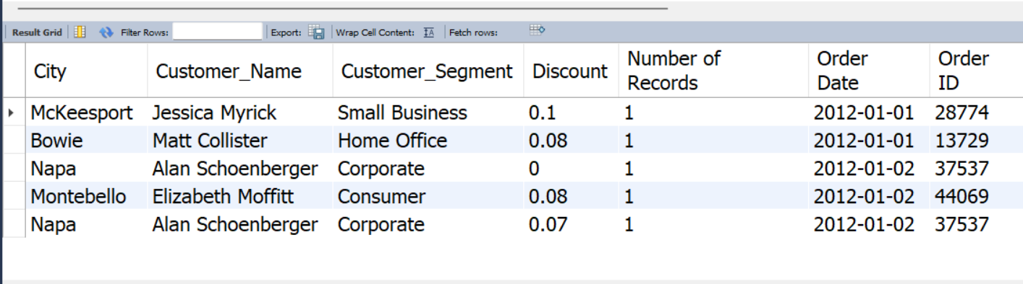

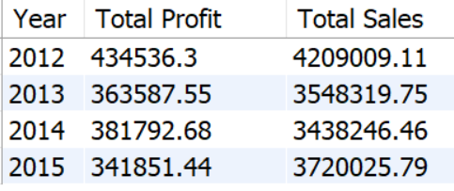
Select *
From Walmart
Limit 5;
let's conduct an exploratory data analysis (EDA) on the Walmart dataset. We'll answer a series of tasks, provide the SQL queries for each task, and then present the results. Once we've completed the analysis, we can transition to creating a dashboard summarizing the key insights.
The first 5 rows and 23 columns of our dataset
What are total sales and total profits of each year?
The years were grouped by order date, so we can observe data for the year 2012,2013,2014 and 2015.
select date_format(order_date,"%Y") as Year,
round(sum(profit),2) as "Total Profit",
round(sum(sales),2) as "Total Sales"
from walmart_sales
group by Year
order by Year asc;
Total sales and Total profits for each year

Slide 4
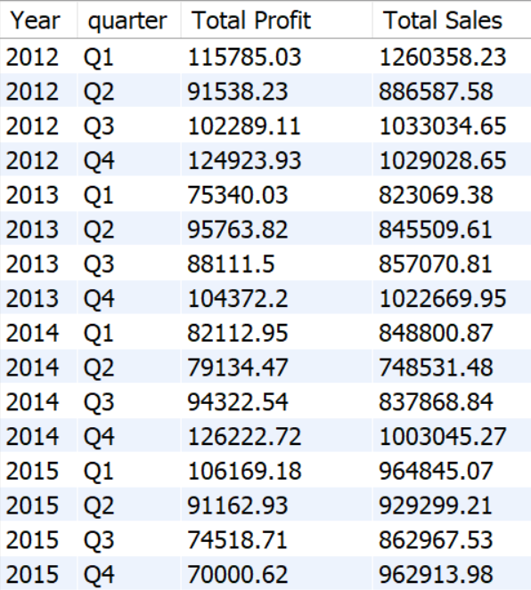
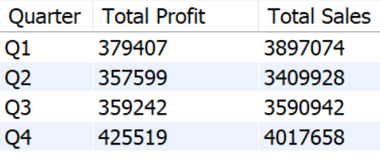
2. What are the total profits and total sales per quarter?
select date_format(order_date,"%Y") as Year,
case
when date_format(order_date,"%c") in (1,2,3) then "Q1"
when date_format(order_date,"%c") in (4,5,6) then "Q2"
when date_format(order_date,"%c") in (7,8,9) then "Q3“
else "Q4“
end as quarter,
round(sum(profit),2) as "Total Profit",
round(sum(sales),2) as "Total Sales"
from walmart_sales group by Year,quarter
order by Year,quarter asc;
Now this table will aid us in knowing what quarters were the most profitable to us from 2012–2015. This can help to pave the way for investment and marketing strategies. Computing the table above through Excel gives us the following :
select case
when date_format(order_date,"%c") in (1,2,3) then "Q1" when date_format(order_date,"%c") in (4,5,6) then "Q2" when date_format(order_date,"%c") in (7,8,9) then "Q3" else "Q4"
end as Quarter,
round(sum(profit),0) as "Total Profit",
round(sum(sales),0) as "Total Sales“
from walmart_sales group by quarter
order by quarter;
The total sales and total profits for each year per quarter
Most performing quarters from 2012–2015

Slide 5

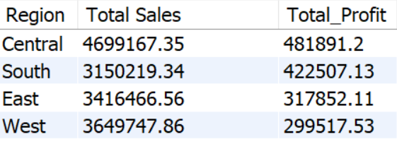
The data above shows that the period of October, November and December consistently emerge as our peak selling months , generating the highest profits. Analyzing this table provides valuable insights for crafting operational strategies, akin to observing a stock market rally from January to December, followed by a downturn in the initial three months. Let’s get into the regions.
3. What region generates the highest sales and profits ?
select Region,round(sum(sales),2) as "Total Sales",
round(sum(profit),2) as Total_Profit
from walmart_sales
group by region order by Total_Profit desc;
1
2
3
Total Profits and Sales by Region
We can observe above that the Central region is the one with the most sales and brings us in the highest profits. The south region is pretty good looking for our company too because less sales but more profit generate. Those 2 regions are definitely areas of interest if we want to maximize our profits and expand our business. Concerning the East region, we do not gain a lot of revenue but still the profits are there. It is the West region that is quite alarming as we generate way more revenue than the East region but do not make at least the same profits over there. The West region should be on our watchlist as we could start to think on how we could maybe put our resources in the other regions instead. Let’s observe each regions profit margins for further analysis with the following code:

Slide 6
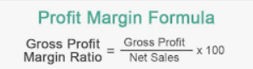
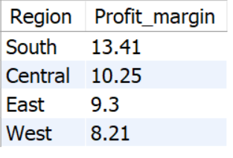
Select Region,
round((sum(profit)/sum(sales))*100,2) as Profit_margin
from Walmart_sales
group by Region
order by Profit_margin desc;
Profit margins by region
Profit margins are a measure of a company’s profitability and are expressed as the percentage of revenue that the company keeps as profit. So we can see that the South and Central are really good in case of sales central region is more selling but less profit_margin of 10.25% in compression to South region profit_margin of 13.41% . The East and west region almost same in terms of profit_margin. Let’s move on and try to pinpoint the data in each region.
4. What state and city brings in the highest sales and profits ?
States
Firstly, Let’s discover what states are the top 10 highest and lowest and then we will move on to the cities. For the states, it can be found with the following code:
select State,round(sum(sales),2) as "Total Sales",
round(sum(profit),2) as Total_Profit,
round((sum(profit)/sum(sales))*100,2)
as Profit_margin
from walmart_sales
group by State
order by Total_Profit desc limit 10;

Slide 7

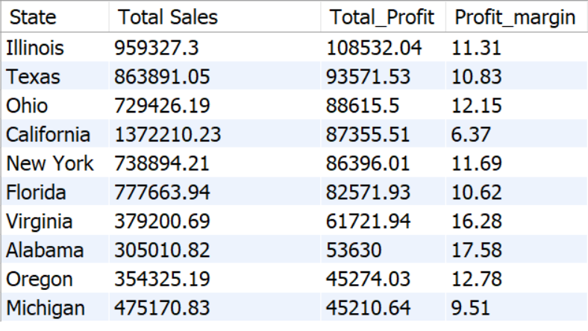
This produces the following result:-
Top 10 State’s total sales and profits with their profit margins
The decision was made to incorporate profit margins to gain a fresh perspective. The data reveals the top 10 most lucrative states, showcasing both total sales and profit margins. Profit margins play a pivotal role, enabling us to adopt a long-term mindset as investors, identifying potential high-yield markets. Illinois, Texas, Ohio, and California emerge as our most profitable markets, with significant sales figures. Their substantial sales volumes indicate that achieving higher profit margins would require considerable effort. Nonetheless, these states yield impressive profits, indicating our dominant market presence. Consequently, we should prioritize bolstering our resources and enhancing customer service in these key states.
Let’s observe our bottom 10 States:
select State,round(sum(sales),2) as "Total Sales",
round(sum(profit),2) as Total_Profit
from walmart_sales
group by State
order by Total_Profit asc limit 10;

Slide 8


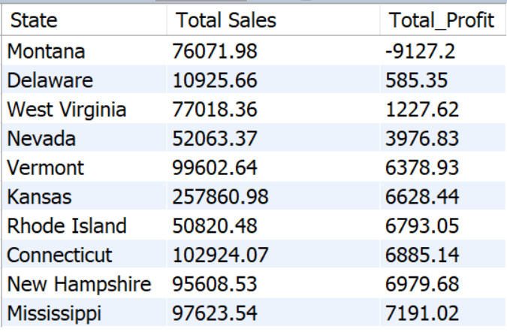
Bottom 10 State’s total sales and profits
The least profitable markets, with Montana, Delaware, and West Virginia topping the list.
In Montana, although sales reach $76,071.98, unfortunately, our profit stands at a loss of -$9,127.2. Delaware, with sales of $10,925.66, fares slightly better, yielding a profit of $585.35. Similarly, West Virginia's sales reach $77,018.36, generating a profit of $1,227.62.
Cities
The top cities are found with the code below:
select City,round(sum(sales),2) as "Total Sales",
round(sum(profit),2) as Total_Profit
,round((sum(profit)/sum(sales))*100,2) as Profit_margin
from walmart_sales
group by City
order by Total_Profit desc limit 10;

Slide 9

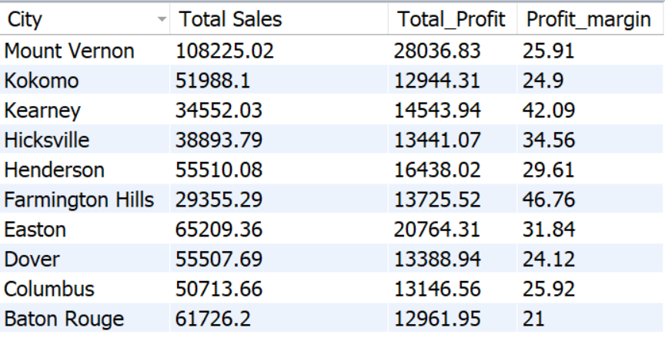
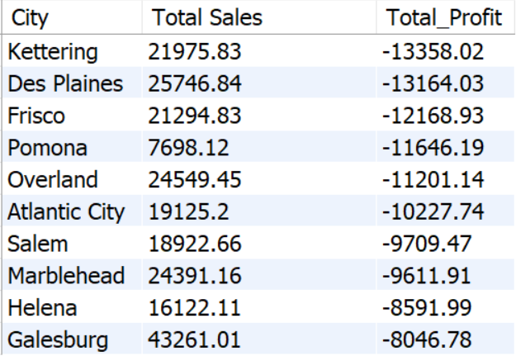

Top 10 Cities’ total sales and profits with their profit margins
The top 3 cities that we should focus on are Mount Vernon, Kokomo and Kearney.
The bottom 10 cities are:
select City,round(sum(sales),2) as "Total Sales",
round(sum(profit),2) as Total_Profit
from walmart_sales
group by City
order by Total_Profit asc limit 10;
Bottom 10 Cities’ total sales and profits with their profit margins
The bottom 3 are Kettering, Des Plaines and Frisco. We have start redesigning some strategies and how we operate in those cities.

Slide 10

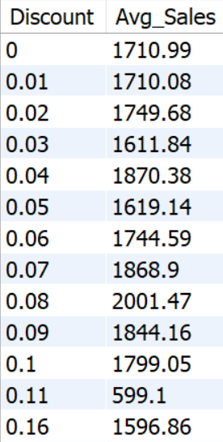

5. The relationship between discount and sales and the total discount per category ?
First, let’s observe the correlation between discount and average sales to understand how impactful one is to the other.
select Discount,round(avg(sales),2) as Avg_Sales from walmart_sales
group by discount
order by discount;
This produces the following:
Discount vs Avg Sales
Seems that for each discount point, the average sales seem to vary a lot. Let’s check the correlation with a graph in Excel

Slide 11

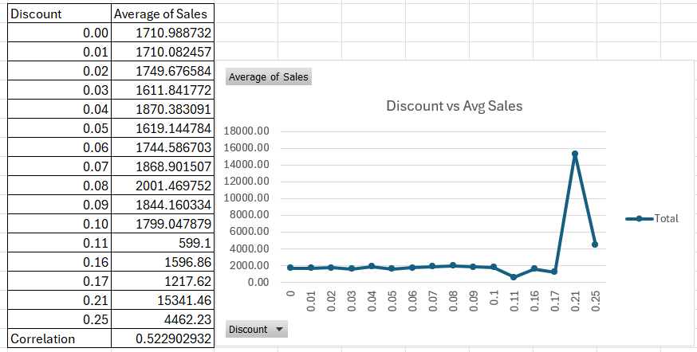
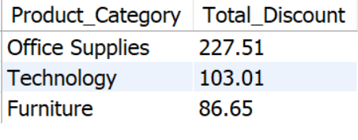
Discount vs Avg Sales correlation graph
They almost have no linear relationship. This noted by the correlation coefficient of 0.522 and the shape of the graph.
Let’s observe the total discount per product category:
select Product_Category,
round(sum(discount),2) as Total_Discount
from Walmart_sales
group by Product_Category
order by Total_Discount desc;
Most Categories
So Office supplies are the most discounted items Technology and Furniture . We will later dive in into how much profit and sales each generate. Before that, let’s zoom in the category section to see exactly what type of products are the most discounted.

Slide 12

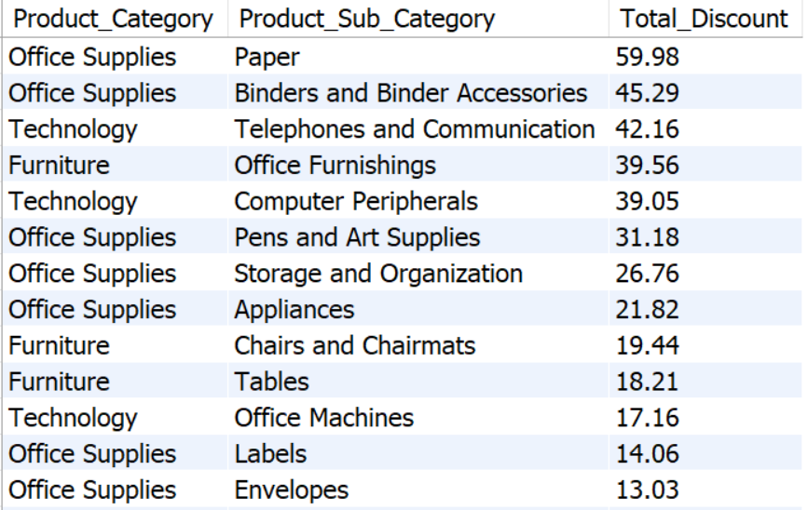
select Product_Category, Product_Sub_Category,
round(sum(discount),2) as Total_Discount
from Walmart_sales
group by Product_Category, Product_Sub_Category
order by Total_Discount desc;
Most discounted Prodsubcategories (product type)
Paper, Binders and Binder Accessories, Telephones and Office Furnishings are the most discounted items. We should check the sales and profits for the Papers and other items on the list. But first let’s move on to the categories per state.

Slide 13



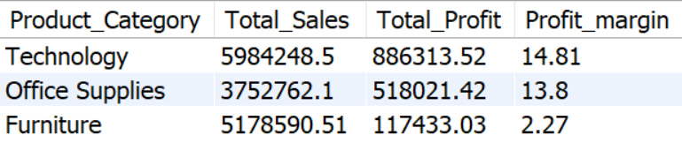
6. What category generates the highest sales and profits in each region and state ?
First, let’s observe the total sales and total profits of each category with their profit margins:
select Product_Category,round(sum(sales),2) as Total_Sales,
round(sum(profit),2) as Total_Profit,
round(sum(profit)/sum(sales)*100,2) as Profit_margin
from walmart_sales
group by Product_Category
order by Total_Profit desc;
Product_Category with their total sales, total profits and profit margins
Among the three categories, it's evident that Technology and Office Supplies stand out for their robust profitability. Plus they seem like a good investment because of their profit margin. To gain deeper insights, let's analyze the regions with the highest total sales and profits within each category. This will provide us with a clearer understanding of each category's regional performance and potential for growth.
Let’s observe the highest total sales and total profits per Category in each region:

Slide 14

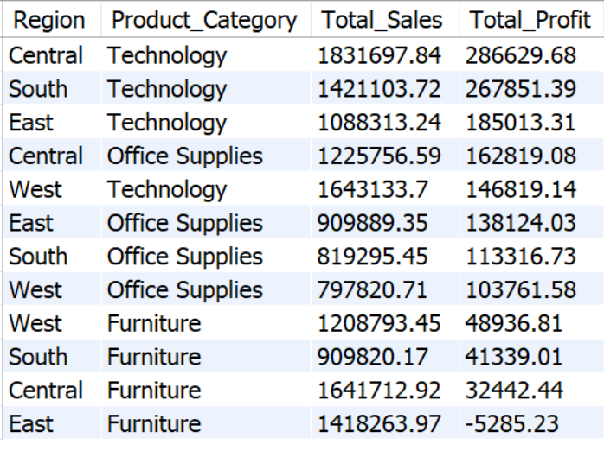
select Region, Product_Category,round(sum(sales),2) as Total_Sales,
round(sum(profit),2) as Total_Profit
from walmart_sales
group by Region,Product_Category
order by Total_profit desc;
Highest total sales and profits per Prod_Category in each region
Our top-performing Product Categories, particularly in terms of total profits, consistently include Technology across the Central, South, and East regions. Notably, the East region experiences a shortfall with Furniture, failing to achieve profitability and operating at a loss in this category.
Now let’s see the highest total sales and total profits per Prod_Category in each state:
select State, Product_Category,round(sum(sales),2) as Total_Sales,
round(sum(profit),2) as Total_Profit
from walmart_sales
group by State,Product_Category
order by Total_profit desc;

Slide 15

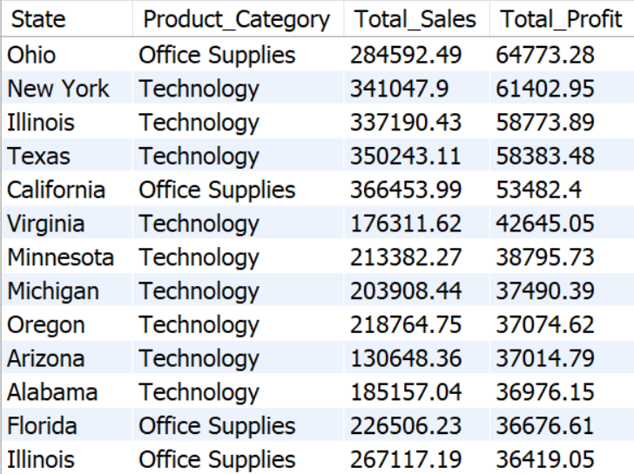
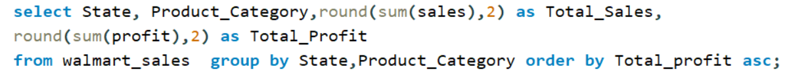
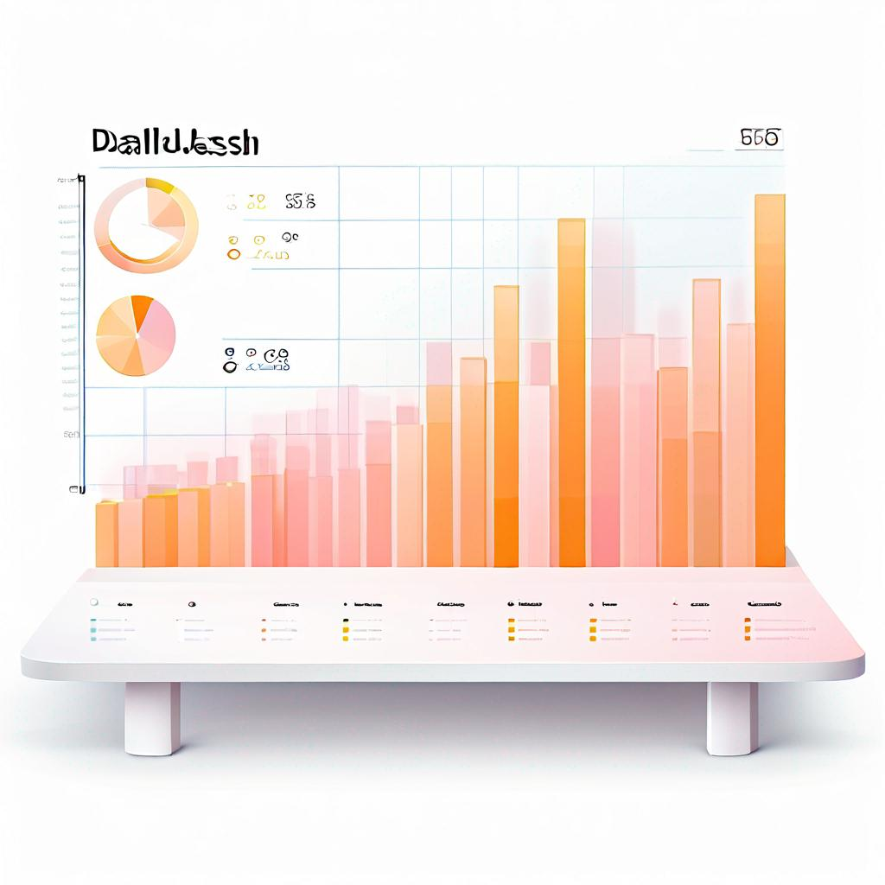
Top Highest total sales and profits per Prod_Category in each state
The table above highlights the top-performing product categories across our states, with Office Supplies leading in Ohio, and Technology reigning supreme in both New York and Illinois. These three categories demonstrate consistent strength across our top markets.
Let’s check the least profitable ones by just changing our ‘ORDER BY’ clause too ascending (ASC)

Slide 16

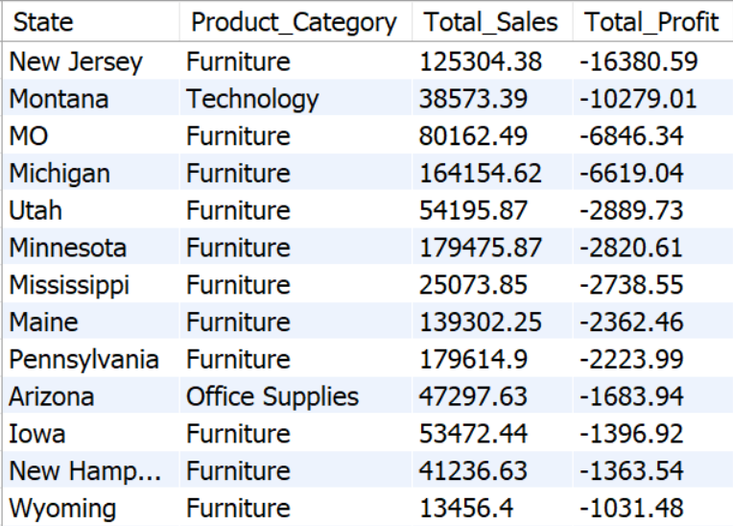
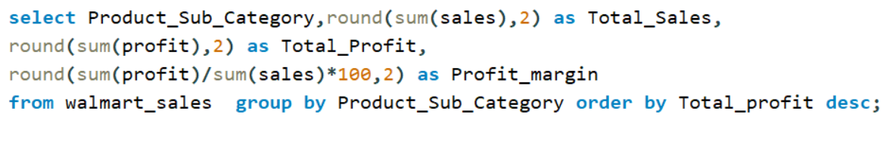
Top Lowest total sales and profits per Prod_Category in each state
Furniture in New Jersey, Technology in Montana, and Furniture in Michigan and Utah emerge as our most significant losses. Now, let's pivot our focus to Product Categories.
7. What Product_Sub_Category generates the highest sales and profits in each region ?
Let’s observe the total sales and total profits of each Product_Sub_Category with their profit margins:

Slide 17

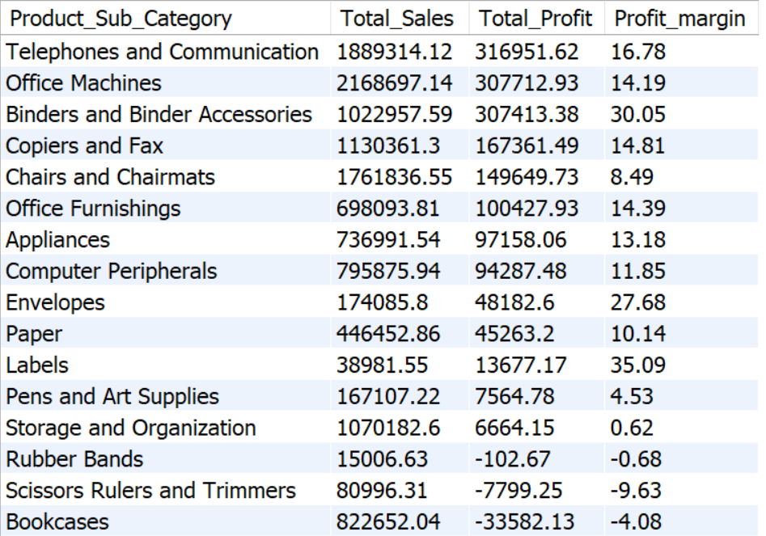
Product_sub_category with their total sales, total profits and profit margins
Out of our 17 Product_sub_category nationwide, our biggest profits comes from Telephones and communication ,Office Machines, Accessories and Copiers and Fax.
The profits and profit margins on Labels and Binders and Binders Accessories especially are interesting for the long run. Our losses came from Bookcases, Scissors Rulers and Trimmers ,Rubber Bands where we are uncapable of breaking even.
Those 3 should be further reviewed as the sales are there, (except Supplies) but we cannot generate profits from them.
Now let’s see the highest total sales and total profits per Product_sub_category in each region:

Slide 18
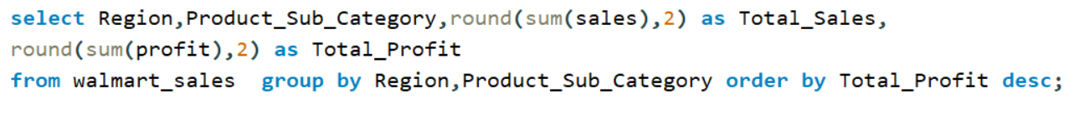
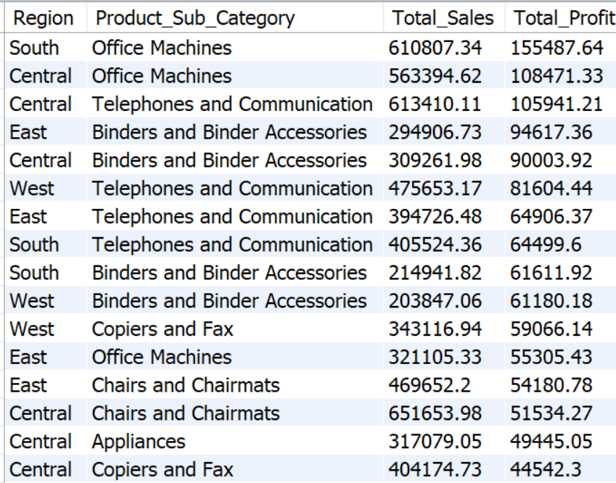

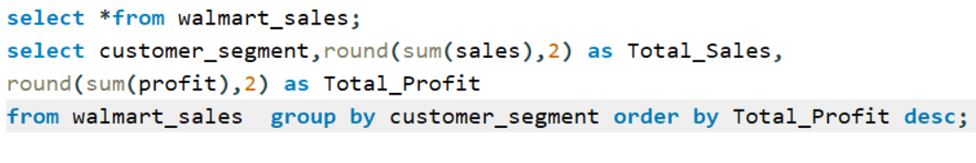
Top 16 Product_sub_category with the highest total sales and total profits in each region
These above display the best Product_sub_category per region.
8. What segment makes the most of our profits and sales ?
This can be verified with the help of the following query:

Slide 19

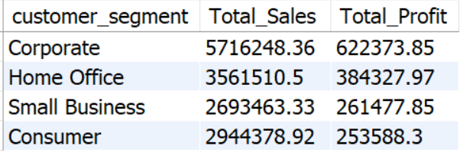
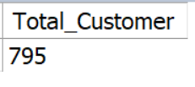
Goods Segment ordered by total profits
The Corporate segment brings in the most profit followed by Home Office, Small Business and Consumer. Let’s move on.
9. How many customers do we have (unique customer IDs) in total and how much per region and state?
This can be solved with the following;
Select count(distinct(Customer_Name)) as Total_Customer
from Walmart_sales;
Total number of customers
We’ve had 795 customers between 2012 and 2015. Regionally, we had the following:

Slide 20
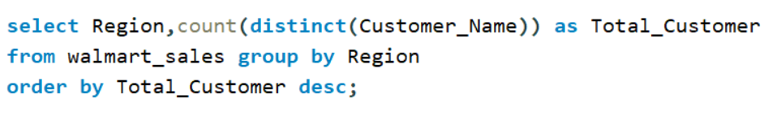
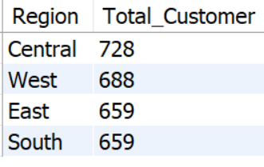

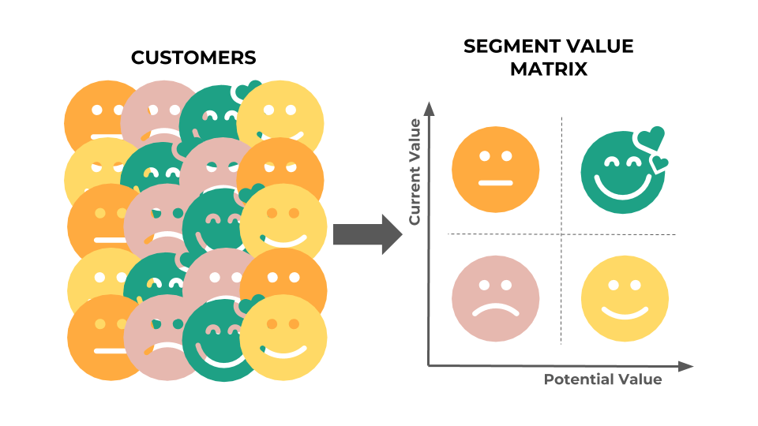
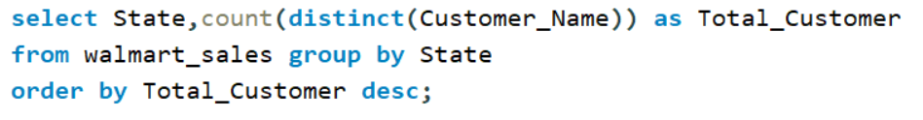
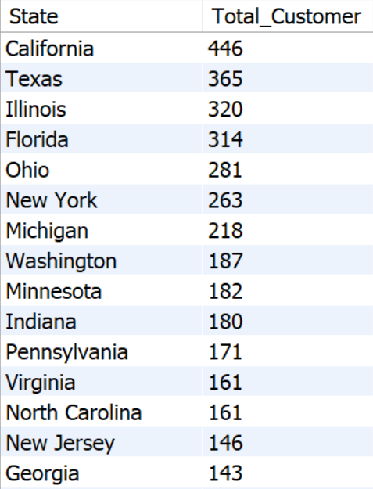
Total customers per region
We surely had customers moving around regions which explains why they all do not add up to 795. Since there could be double counting. The Central is the area where we have the biggest market of all. State wise, here are the numbers:
We have the most customers in California, Texas and Illinois. The areas where we have the least that passed by there are:
Top 15 states with the most customers

Slide 21
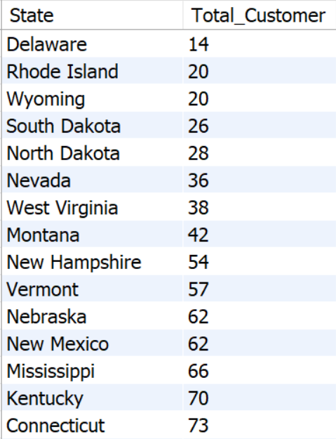

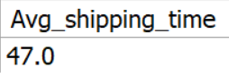
select State,count(distinct(Customer_Name)) as Total_Customer
from walmart_sales
group by State
order by Total_Customer asc;
Delaware, Rhode Island and Wyoming are the places where we had the least customers carry on business with us there.
Top 15 states with the least customers
10. Average shipping time per class and in total.
Finally, the average shipping time regardless of the shipping mode that is chosen is found with the following function:
select round(avg(Ship_Date - Order_Date),1) as Avg_shipping_time
from walmart_sales;

Slide 22



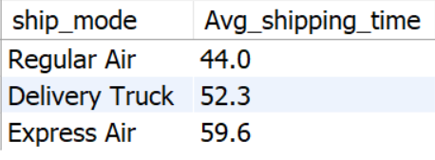
The shipping time in each shipping mode is:
select ship_mode,
round(avg(Ship_Date - Order_Date),1) as Avg_shipping_time
from walmart_sales
group by ship_mode
order by Avg_shipping_time;
Average shipping time by shipping mode
Here we have all the information we need to transition to our Tableau dashboard. The data visualization is our following step.

Slide 23
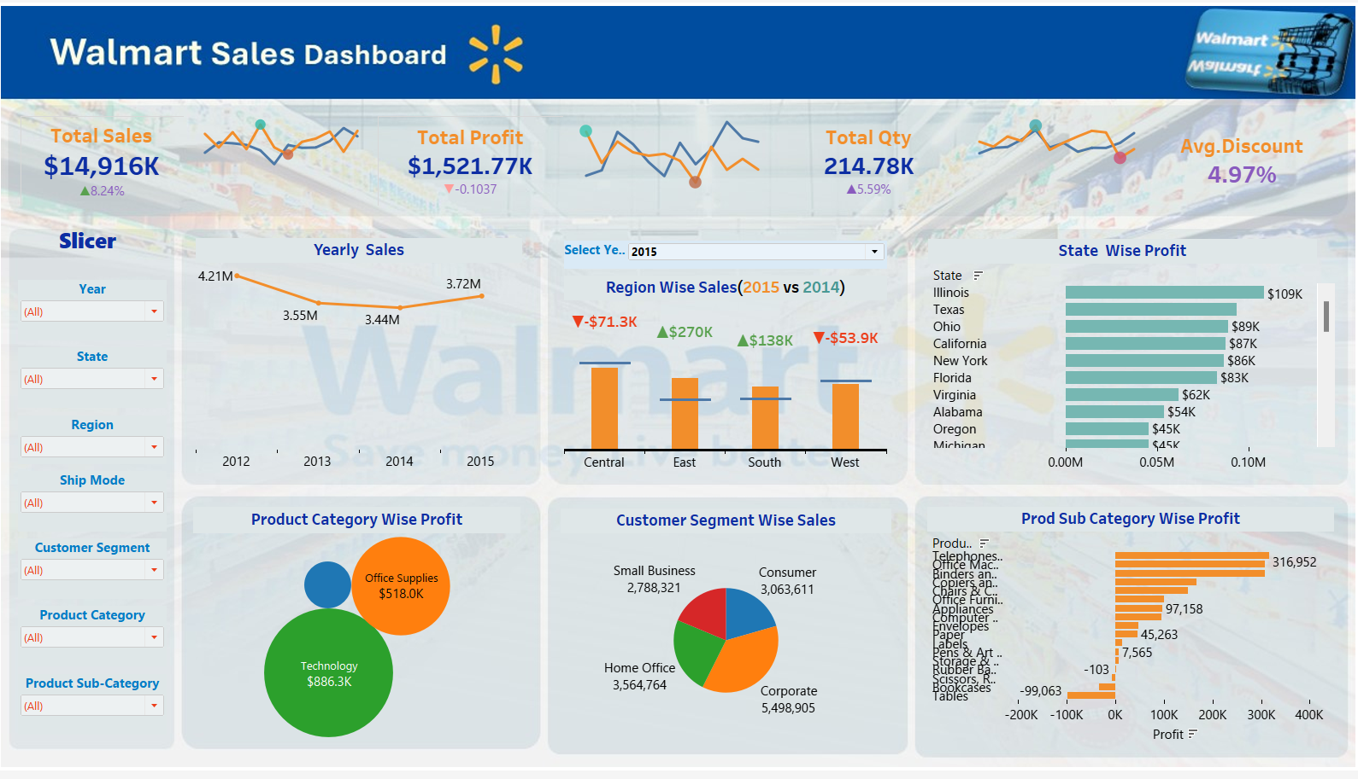
Step 5: Share
Onto sharing our observations, below you will find a picture of the interactive dashboard that represents the main KPIs and information on the collected Walmart data which was realized and demonstrated with Tableau.
The link to the interactive dashboard will be found under the
screenshot below. Here are our findings:
This is an in depth analysis of the Walmarts dataset. You will find interactive dashboards focused on the yearly sales dashboards displaying data collected from 2012–2015.
If there is mainly an interest in the yearly (timeline) data on profits, categories, sub categories, segments and products, then below you will find the direct link to the dashboard:
https://public.tableau.com/app/profile/goutam.kuiri/viz/Walmartretailproject/WalmartSalesDashboard
This is an in depth analysis of the Walmarts dataset. You will find interactive dashboards focused on the yearly sales dashboards displaying data collected from 2012–2015.
If there is mainly an interest in the yearly (timeline) data on profits, categories, sub categories, segments and products, then below you will find the direct link to the dashboard:

Slide 24
Conclusions and Future Recommendations
1
Steady Improvement in Profits and Sales
Our profits saw a steady improvement, with sales also experiencing growth despite a brief pause in 2012. Let's strive to maintain this momentum going forward.
2
Focus on Q4 Profit Maximization
Our peak in profitability consistently occurs during Q4.To maximize even more profits, we must make sure to have enough stock and
push our marketing and customer service to make the most out of the October — December festive period.
3
Regional Performance Analysis
The most performing regions are the Central then the South, East and West regions in that order. The West region brings in atleast $100,000 more in sales than the East region but still makes less profits than it. There is work to be done in the West region if we really want to keep that market. However, I believe it is better to take some of the resources in our West region to instead our Central region stores as we are more profitable there and could really establish ourselves as kingpin in that region.
4
Market and Segment Insights
Illinios, Texas and Ohio are most profitable market and most present ones ones especially in terms of sales as states. We have to focus more on them. Our least Profitable markets are Montana, Delaware and West Virgina. Which I believe that we should decrease our presence there or even put a halt at our store locations there as sales in Montana and Delaware are in the $100,000s but are unable to convert to profits
5
Clientele and Market Presence
Out of the 4 segments, The corporate segment brings in the most profit followed by Home office, Small Business and then Consumer. We must
give more importance to the corporate segment even if all the 4 are profitable.
Finally, for our clientele, we have 795 customers total, and we have the most customers in California, Texas and Illinois. California and Texas are pretty obvious, we have to be outstanding and be the best of what there is to offer in our respective niche.
Thank you for your interest and time. Feel free to give your valuable suggestions and connect with me
https://www.linkedin.com/in/goutam-kuiri-949b632a6

